Slide 1
Ethics in AI
Criminal Justice
Mentor: Ting Li
Research and Development: Saanvi Gupta, Neel Bansal, Aahan Shah, Hannah Luo, Linh Nguyen

Slide 2
Table of contents
01
02
03
04
05
06
Introduction
Relevance
Investigation
What We are Trying to Achieve through this Project
Artificial Intelligence in criminal justice
Our Plan to Mitigate Racial Bias
Databases
Methodology
Conclusion
COMPAS and Python Libraries
How we Implemented our Solution
Our Findings
Notes:
01 Introduction - Hannah
02 relevance - linh
03 investigation - Neel
04 - Aahan Databases
05 Methodology - Saanvi
06 Conclusion

Slide 3
01
Introduction
What We are Trying to Achieve through this Project

Slide 4
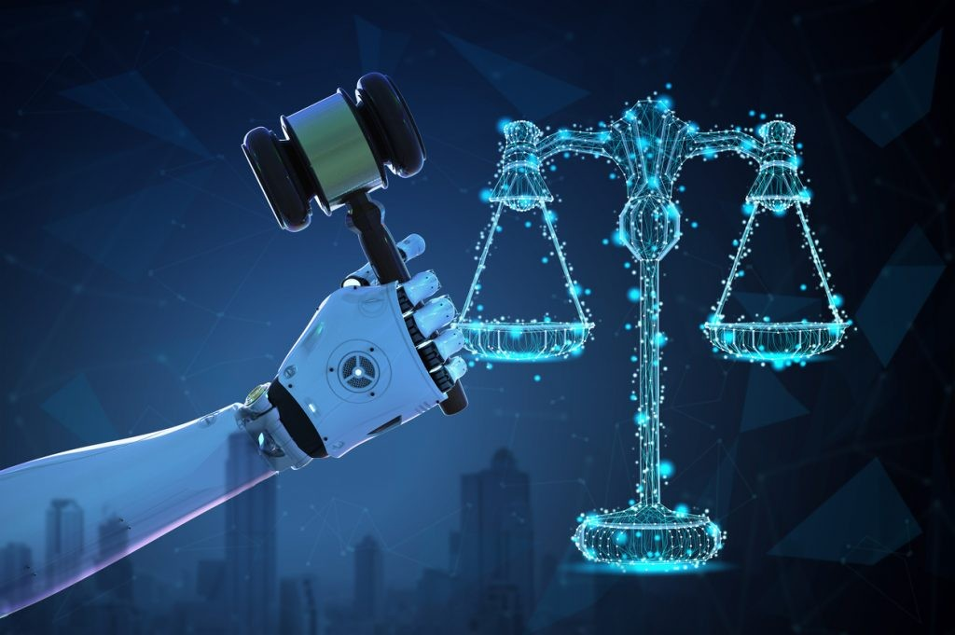
Project Goals
The goal of this project is to use AI to uncover and to study how biases (specifically, racial biases) impact the rates predicted by common criminal recidivism prediction tools such as COMPAS.

Slide 5
02
Relevance
Artificial Intelligence in Criminal Justice

Slide 6

AI in the criminal justice system
Assess the likelihood of an individual committing future crimes
Sentencing decisions
Used to predict defendant’s likelihood of recidivism
Bias, discrimination and fairness
Notes:
AI technology is critical to increasing the efficiency and accuracy of the justice system. Large datasets, such as court documents, surveillance footage, and criminal histories, can be analyzed by AI algorithms to find patterns and produce insights that can be used in investigations and decision-making.
Furthermore, AI can be used to assess the likelihood of an individual's future criminal behavior, informing decisions related to parole, probation, or release conditions. This aids in choosing the best rehabilitation plans, judgments regarding parole, and terms of pretrial release.
Through past criminal records and socioeconomic factors, AI algorithms can analyze vast amounts of data to provide judges or parole boards with recommendations for sentences or release conditions. Various tools of AI helps the Law Enforcement Agencies to identify doubtful patterns which are not detected by humans for crime prevention.
It can also be used to predict defendant’s likelihood of recidivism by analysing criminal justice data to predict new offences of absconding offenders.
Although AI operates without human assistance, it is created by humans, therefore there’s still room for error. All datasets introduced in AI algorithms to generate results are human data, meaning they already contain human bias, which are then passed on in AI results.

Slide 7
03
Investigation
Our Plan to Mitigate Racial Bias

Slide 8
Why is it important to remove bias?
Bias in AI systems erodes trust in the technology and the institutions that use them.
If an AI model is trained on biased data or incorporates biased features, it can reinforce existing societal prejudices and stereotypes.
Biased AI predictions can result in individuals being subjected to unjustified surveillance, denial of opportunities, or excessive punishment, violating their human rights

Slide 9
How we plan to reduce bias
Identify and Address Biased Variables: Analyze the input variables used in the model to identify any potential biases. Examine whether certain variables, such as race or socioeconomic status, are proxies for bias and remove them if possible.
Bias can also arise from human decision-making during the data labeling and model training process.
Ensure that the training data used to develop the AI model is diverse and representative of the population it aims to predict for.

Slide 10
04
Databases
COMPAS and Python Libraries

Slide 11

COMPAS (Correctional Offender Management Profiling for Alternative Sanctions)
What is COMPAS? - It is an algorithm risk-assessment tool that attempts to predict whether a defendant is likely to reoffend (recidivate).
This is specifically used in the pre-trial phase and based on particular characteristics about a defendant, the model would predict whether or not someone is likely to commit another crime if released.
This software is majorly used in states such as: U.S. jurisdictions, including New York, Wisconsin, California, and Broward County, FL.

Slide 12





Python Libraries Used
The following is just a list of python libraries used in this project:
Pandas - This tool is a Python-based open-source data analysis and manipulation solution that is fast, powerful, flexible, and user-friendly.
Numpy - Python library for efficient numerical operations and array manipulation.
sklearn - Scikit-learn is a Python library for machine learning, providing a wide range of tools and algorithms for data analysis, modeling, and evaluation
matplotlib - Matplotlib is a Python library for creating visualizations and plots, giving extensive customization options to effectively communicate and explore data.

Slide 13
05
Methodology
How we Implemented our Solution

Slide 14
General Overview
1
2
3
Building a competitive machine-learning model on the COMPAS dataset.
Analyzing bias and fairness on the COMPAS dataset.
Exploring and justifying fair models on the COMPAS dataset; discussing fairness in machine learning beyond COMPAS.

Slide 15
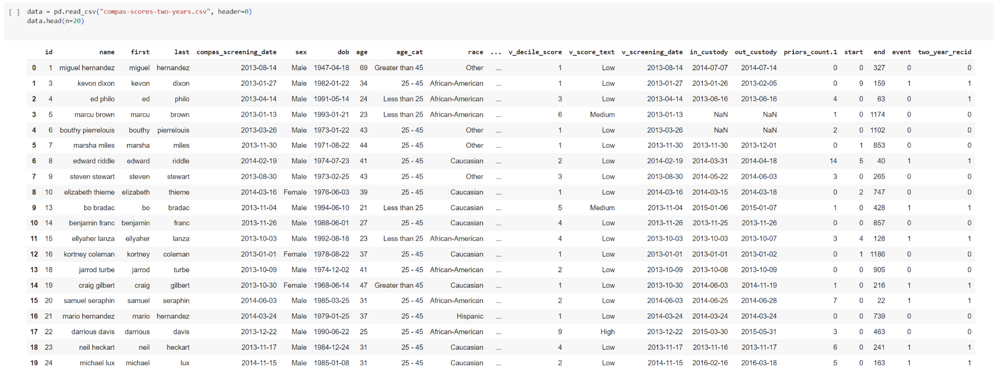
Notes:
Using this bit of code, we were able to pull the COMPAS dataset

Slide 16
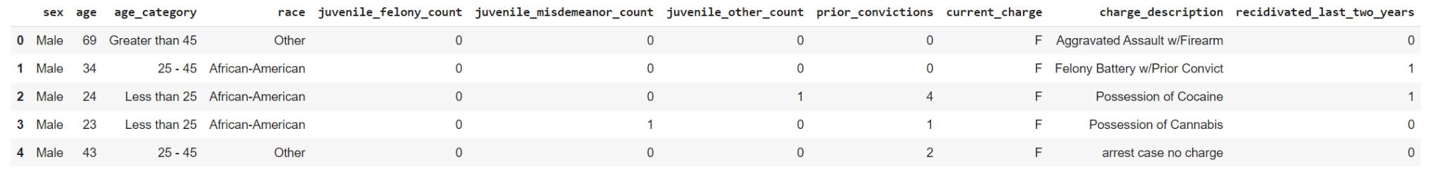
Notes:
After looking at our fields, we filtered out the ones that weren’t relevant to our investigation by turning some of our variables from text into one-hot categories for input into our model and then used that dataset to continue our investigation. An example of part of the dataset is shown above.

Slide 17
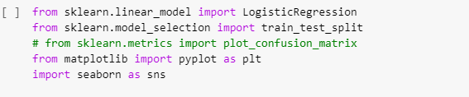
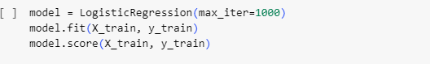
Notes:
We set this up as a supervised learning problem. In the supervised setting, we are given data points X and target y. We ran our model on input X, and compared our prediction with the expected output y. Basically, we want our model to learn a mathematical function y = f(X) so that there is little error between our predictions and expected output y.
Our model will be attempting to learn a function from the defendant information to whether they will recidivate in a two-year period.
We'll be using the Keras framework to develop deep neural models, and scikit-learn to set up some baselines.
In the first picture, we imported some libraries that we then utilized to help test and train our model. In the second picture, we used the code to create a 70-30 split on the training data. We then used logistic regression to build, fit, and test our model for 1000 iterations, as shown in the third picture.

Slide 18
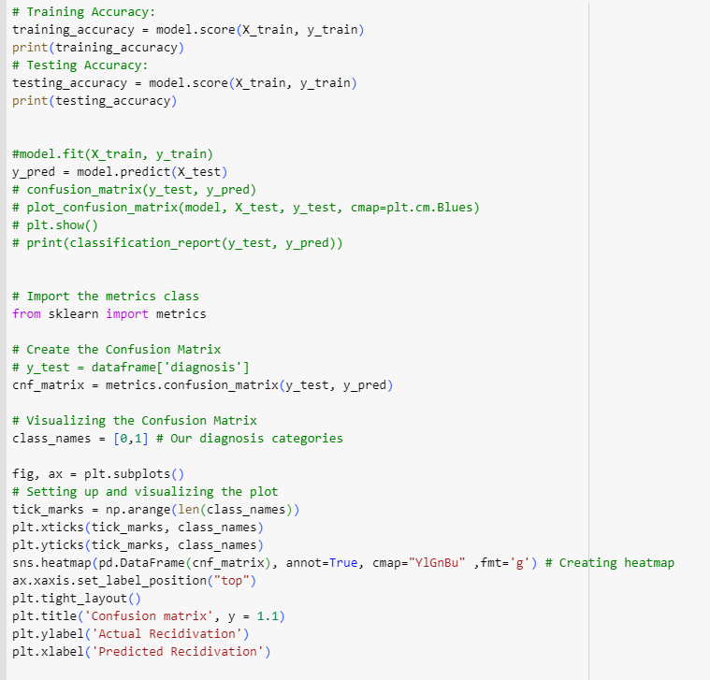
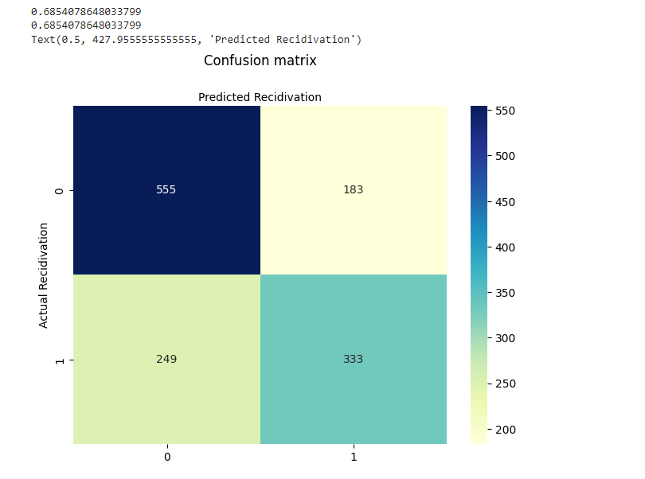
Notes:
Using the code on the left, we derived the accuracies of our training and testing data, and then plotted a confusion matrix to show the number of false positives and negatives and the number of true positives and negatives. We found that our accuracies for the training and testing data were in the mid to high 60s, which isn’t a great percent number when it comes to incarceration.

Slide 19
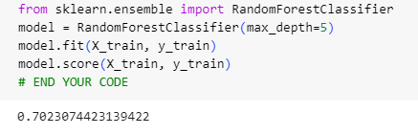
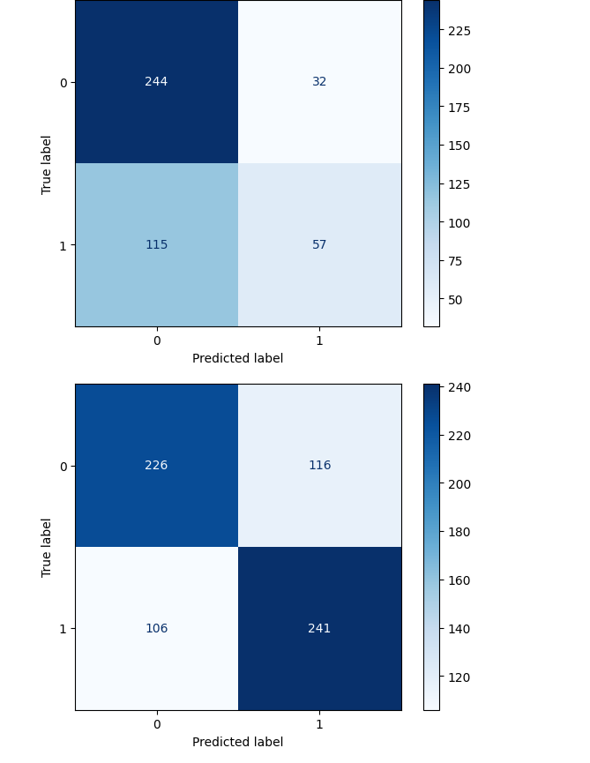
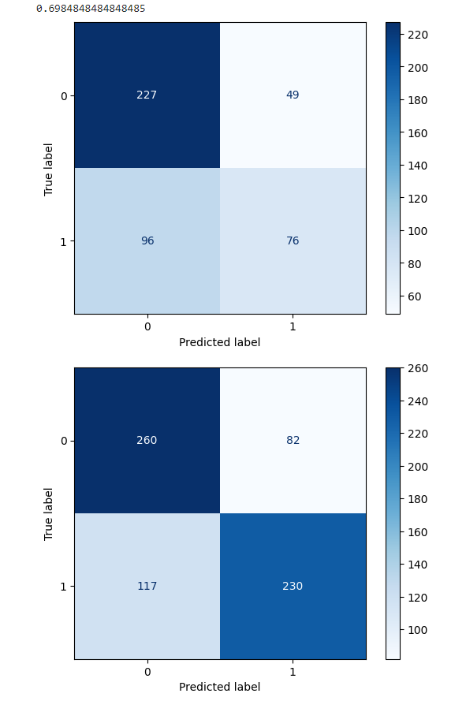
Notes:
Since we weren’t able to get a great accuracy, we tried building our model again using the RandomForest Classifier, and we were able to boost the accuracy to about 70% which was a bit higher than our Logistic Regression model. Using our new model, we created testing splits for our data. In the confusion matrix on the left, we left race as a variable and found that the rate of false positives for recidivation of African American men was nearly double the rate of false positives for caucasian men. We then removed race as a variable from our test splits entirely and noticed that the results didn’t change much, even after removing race. For the sake of time, i’ll skim over the rest of the methodology. Essentially we built another model using different probability formulas - one was in the interest of group fairness, and this method was called statistical parity, and one was in the interest of test-fairness, otherwise known as calibration.

Slide 20
06
Conclusion
Our Findings

Slide 21
We need to build a more fair model. All the models we experimented with turned up some kind of bias, and quite low accuracy. We suggest that all models that get built are tested with white-box testing so that we can see exactly where the model is preventing a fair and/or accurate decision of risk factor.

Slide 22
Thanks!

